Slide 1
CrackGPT – AI Interview Simulator
Team:
Subhadeep Sing
Abhishek Kumar Jha
Aditya Deshmukh
Mohd Ayaan
Manish Seervi

Slide 2
The Problem
Technical interviews are getting increasingly competitive
Existing tools provide static, repetitive question banks
No personalization based on job role or difficulty
No real voice-based simulation or soft‑skill evaluation
Students cannot receive structured, actionable interview feedback

Slide 3
Why Current Tools Fail
Random question sets with no context awareness
No behavioural + situational + technical mix
No AI-based scoring
Mock interviews with humans are costly and inconsistent

Slide 4
Our Idea – CrackGPT
End‑to‑end AI‑powered mock interview platform
Analyses job description to extract relevant skills
Generates role‑specific questions
Records voice, transcribes, evaluates answers
Gives scoring, strengths, weaknesses, improvements

Slide 5
High‑Level System Workflow
Initial Workflow (Version 1)
Tech Used:
Whisper (ASR)
Gemini via AI Studio
ElevenLabs (TTS)
Problem:
AI Studio gives only 3 API calls per minute, so real-time experience was impossible.

Slide 6
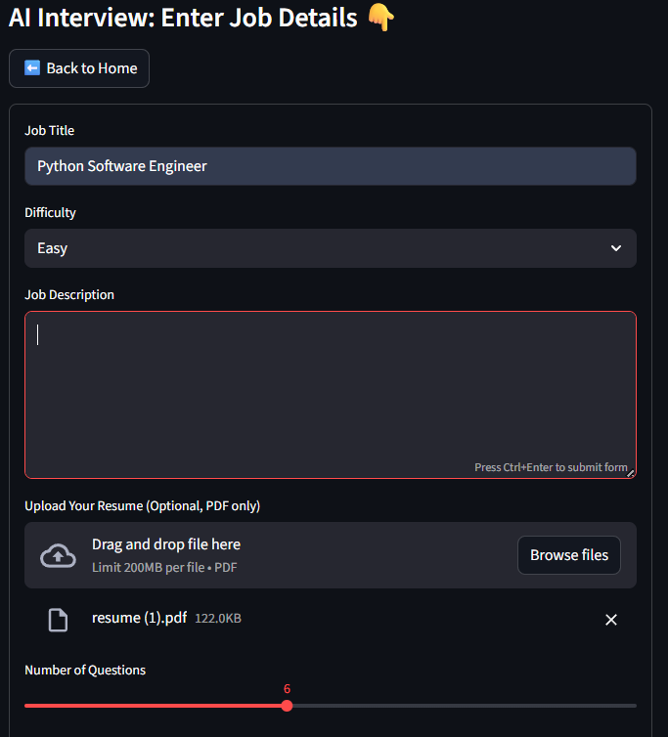
How Version 1 Worked
User Flow:
User uploads resume + job description
Selects difficulty: Easy / Medium / Hard
System generates 5 questions at once
For each question:
  A random number (0–2) is generated
  If 0 → next question
  If 1 → generate 1 follow-up question using Gemini
  Continue until the 5 main questions finish
Limitation:
Not realistic due to API rate limits
Follow-up questions were minimal
Not real-time

Slide 7
Voice Interview Simulation
• Streamlit’s browser‑based audio recorder
• Faster‑Whisper for real‑time transcription
• ElevenLabs for lifelike interviewer voice
Problems With Version 1
Could not test properly due to API limitations
Interview felt static, not like a conversation
No automatic VAD (voice activity detection)
Not possible to ask multiple follow-ups
Manual button presses (start/stop)

Slide 8
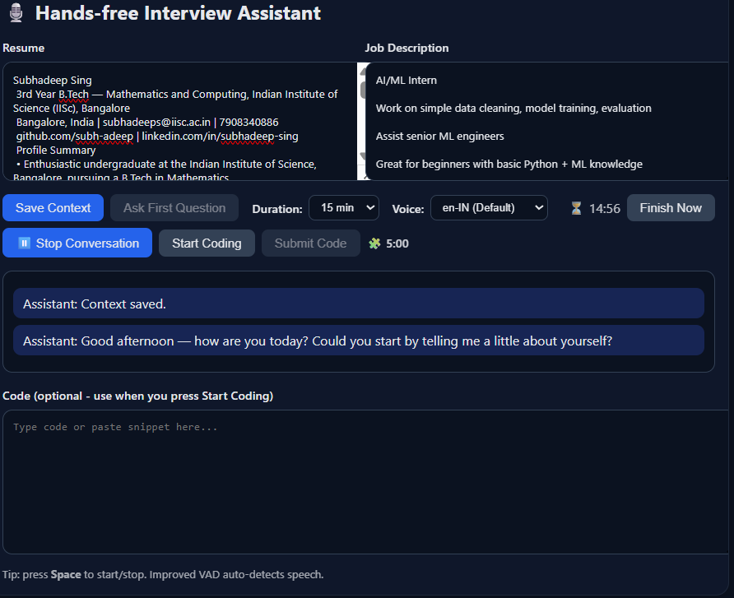
Improved Workflow (Version 2)
Tech Used (Google Cloud):
Google Cloud Speech-to-Text v2
Gemini 2.5 Flash via Vertex AI
Google Cloud Text-to-Speech
Uses $300 free credits → no rate limit problems

Slide 9
How Version 2 Works
Real-time pipeline (like Google Assistant):
User speaks → STT transcribes instantly
Transcript → Gemini 2.5 Flash → live follow-up logic
Gemini → TTS → assistant speaks immediately
Automatic pause/play, auto-record, no buttons needed
More follow-up questions allowed since Cloud Vertex AI has high rate limits

Slide 10
Final Workflow Diagram
Real-time VAD (auto start/stop on speech)
Dynamic follow-up questions
Higher quality TTS
Live coding window for coding questions
More natural “interviewer” tone
Pipeline feels like a real human conversation

Slide 11
WHY NOT ASR?
For continuous feedback, need continuous processing
Need for separate VAD
If stopped at pauses, hard to detect pauses in speech and speech finishes
Tried for 10 and 15 sec chunks
Due to latency in processing Transcripts, lag between transcript processing and audio processing

Slide 12
WHY STT??
Low latency <- better cloud GPUs
No need for separate VAD or silence detection
Works well for varying answer durations
Better audio processing (noise suppression etc)

Slide 13
Pipeline and Latency Analysis
Client: Microphone→ VAD → Media Recorder
Upload: Blob → Server (Flask) receives bytes.
STT: Google Speech-to-Text v2 (sync) — typical 1–3 s latency.
LLM: Gemini — generate concise question; quality guards applied.
TTS: Google TTS → MP3 data URI; client pauses VAD during playback.

Slide 14
AI Evaluation Module
Scoring of each answer
Strengths and improvement points
Better phrasing suggestions
Keyword coverage analysis

Slide 15
How AI feedback is generated
Input Acquisition
Live Conversation: SocketIO, WebSockets with speech-to-text (STT)
Conversation Context: Maintains full dialog history
Prompting Architecture:
Primary System Prompt -> Few-Shot Examples
Structured Output Format

Slide 16
AI Integration Points
Feedback Generation
Text-to-Speech: Audio summaries generated from feedback text
Context Preservation
Client-Side Processing: parseFeedback() function extracts structured data from AI-generated text
Statistical Corrections
Real-time Updates: WebSocket-powered live results display.

Slide 17
Integration Overview
Initially planned separate React.js frontend and Flask (Python) backend connected via endpoints
Integration divided into three key modules: Question Generation, Interview Flow, and Feedback
Question Generation & Feedback were straightforward due to fixed input–output formats
Major complexity came from the dynamic and evolving audio pipeline
Frequent backend updates required continuous frontend adjustments

Slide 18
Implementation
Shifted focus to stabilizing backend first, due to changing audio logic
Used a minimal vanilla HTML/CSS/JS frontend initially to test backend endpoints quickly
Ensured all backend routes were consistent, well-defined, and versioned
Gradually built a more refined UI once backend audio workflows were stable
Final integration achieved smooth flow across all stages:

Slide 19
Team Contributions
Workflow – Subhadeep and Abhishek
Audio Pipeline – Aditya and Subhadeep
Prompting – Manish and Subhadeep
Feedback – Abhishek and Manish
UI – Ayaan and Aditya
Integration – Ayaan

Slide 20
Conclusion
CrackGPT delivers a realistic, adaptive, AI‑powered mock interview experience
Helps students prepare more effectively
Extensible into full career‑prep platform

